Slide 1
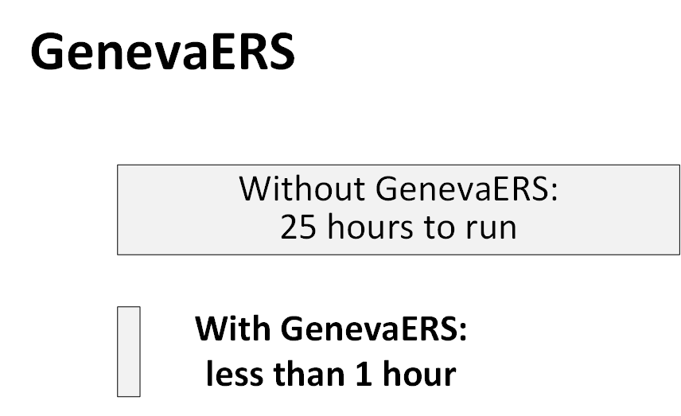

Slide 2
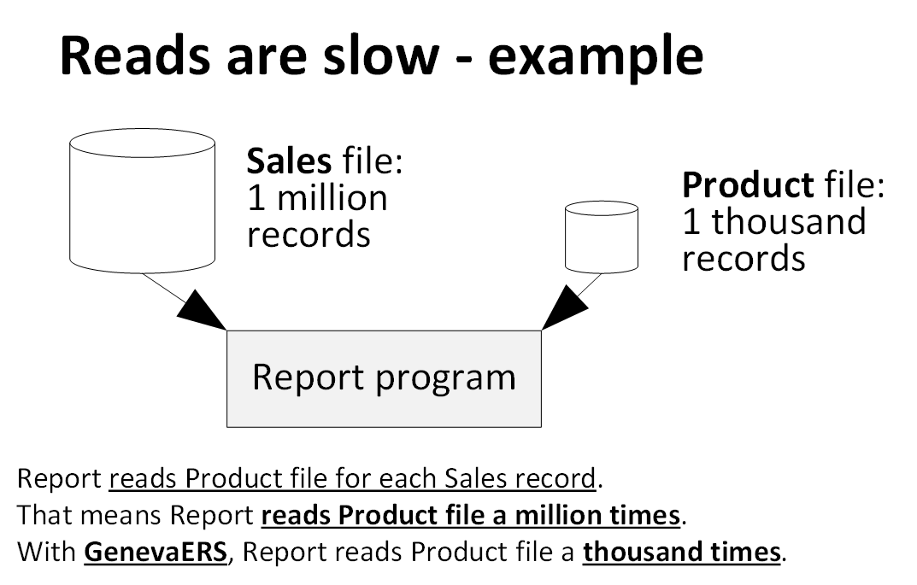

Slide 3
GenevaERS
Is free
Does the programming for you to avoid unnecessary reads
During this video, GenevaERS did the following:
Scanned half a billion records
Wrote 65 millions records
Performed 60 million joins
Using less than 60 elapsed seconds
Using 13 CPU seconds
Find out more at https://genevaers.org/

